Slide 1
Attacking Data Independent Memory Hard Functions
Jeremiah Blocki (Microsoft Research/Purdue)
Joel Alwen (IST Austria)

Slide 2


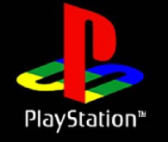


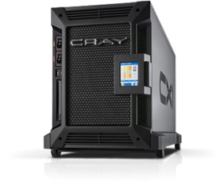

Motivation: Password Storage
jblocki, 123456
Username
jblocki
Salt
89d978034a3f6
Hash
85e23cfe0021f584e3db87aa72630a9a2345c062
SHA1(12345689d978034a3f6)=85e23cfe0021f584e3db87aa72630a9a2345c062
+
Notes:
Suppose that I register for an account at playstation.com

Slide 3

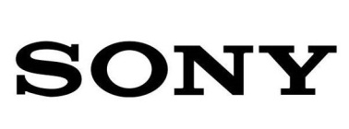






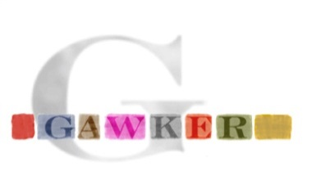


Offline Attacks: A Common Problem
Password breaches at major companies have affected millions of users.
Notes:
Unfortunately, offline dictionary attacks are quite common. Password breaches at major companies have affected millions of users.

Slide 4
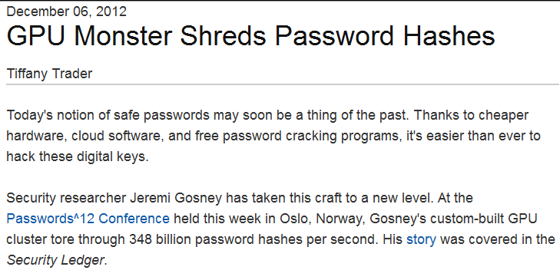
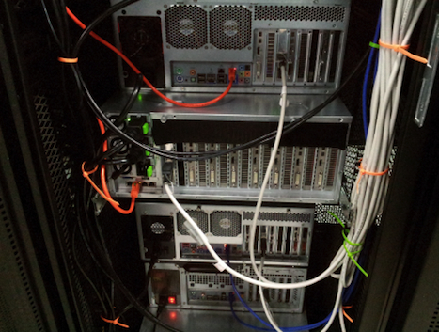
Notes:
Offline dictionary attacks are also very powerful. Some password hash functions can be evaluated at 348 billion hashes per second! How can we defend against these attacks?

Slide 5
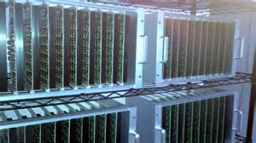




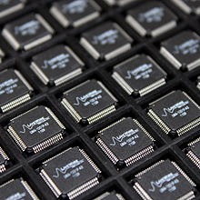
Goal: Moderately Expensive Hash Function
Equitable Cost?
Notes:
One proposed defense is to intentionally make the cryptographic hash function more expensive to evaluate by using a cryptographic hash function like BRCRYPT or sCrypt. The tradeoff is that making the hash function more expensive to evaluate increases costs for the adversary and a legitimate server.
Note: This slide could be skipped if the presentation is too long.

Slide 6
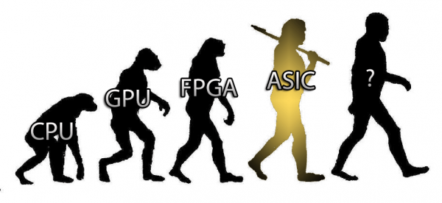
Bitcoin Mining (SHA256) is not Equitable!
Cost(SHA256) varies by a factor of 10⁶

Slide 7
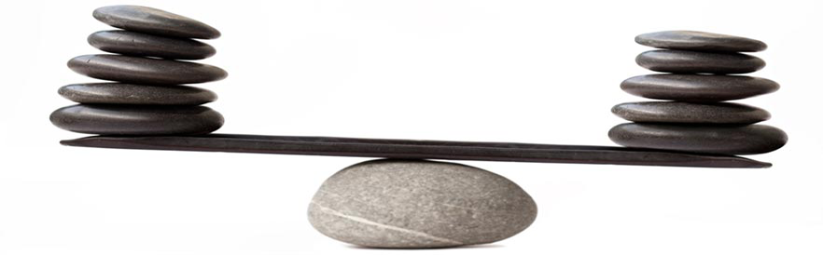
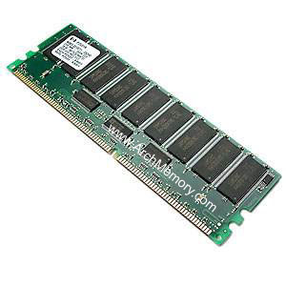
Memory Costs: Equitable Across Architectures

Slide 8
Outline
Motivation
Data Independent Memory Hard Functions (iMHFs)
  Graph Pebbling
  Measuring Pebbling Costs
  Desiderata
Attacks iMHFs
Constructing iMHFs (New!)
Open Questions

Slide 9

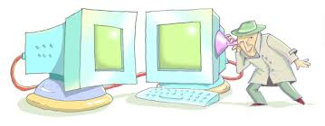
Memory Hard Function (MHF)
Intuition: computation costs dominated by memory costs
Data Independent Memory Hard Function (iMHF)
  Memory access pattern should not depend on input

Slide 10


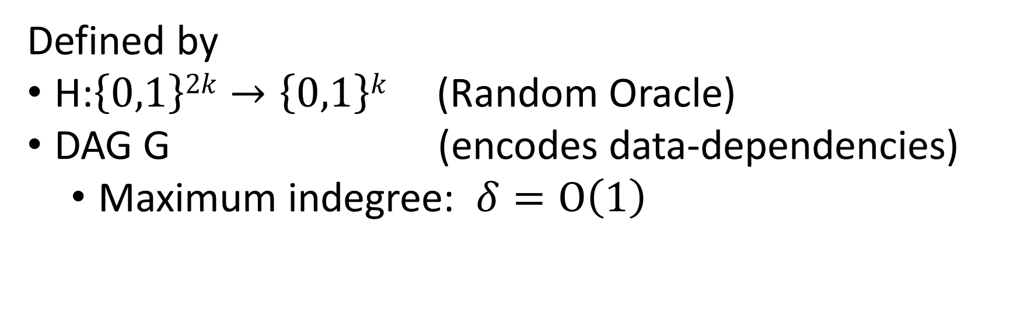
iMHF (f_{G,H})
Defined by
H:$\left\{0,1\right\}2k→\left\{0,1\right\}k$ (Random Oracle)
DAG G (encodes data-dependencies)
  Maximum indegree: $δ=O\left(1\right)$
2
4
Input:
Output: f_{G,H} (pwd,salt)= L₄
1
1
pwd, salt
3
$$L1=H(pwd,salt)$$
$$L3=H(L2,L1)$$

Slide 11

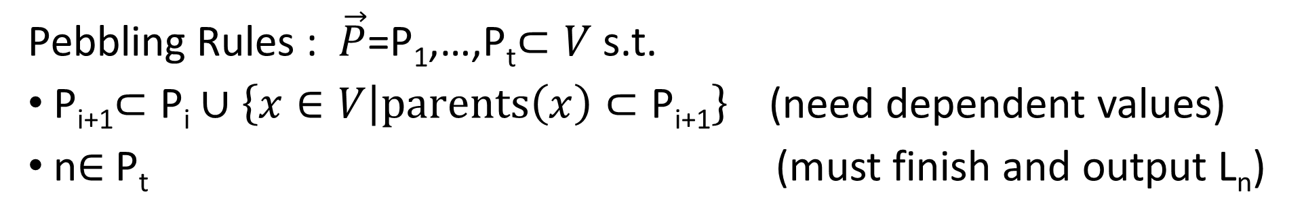

Evaluating an iMHF (pebbling)
2
4
Output: L₄
Input:
1
1
pwd, salt
3
$$L1=H(pwd,salt)$$
$$L3=H(L2,L1)$$
Pebbling Rules : $\vec{P}$=P₁,…,P_{t}$⊂V$ s.t.
P_{i+1}$⊂\text{P}\text{i}∪\left\{x∈V | parents\left(x\right)⊂\text{P}\text{i}\text{+1}\right\}$(need dependent values)
n$∈$P_{t} (must finish and output L_{n})

Slide 12
Pebbling Example
4
5
3
4
5
1
3
1
2

Slide 13
Pebbling Example
1
2
3
4
5
P₁ = {1}

Slide 14
Pebbling Example
1
2
3
4
5
P₁ = {1}
P₂ = {1,2}

Slide 15
Pebbling Example
1
2
3
4
5
P₁ = {1}
P₂ = {1,2}
P₃ = {3}

Slide 16
Pebbling Example
1
2
3
4
5
P₁ = {1}
P₂ = {1,2}
P₃ = {3}
P₄ = {3,4}

Slide 17
Pebbling Example
1
2
3
4
5
P₁ = {1}
P₂ = {1,2}
P₃ = {3}
P₄ = {3,4}
P₅ = {5}

Slide 18
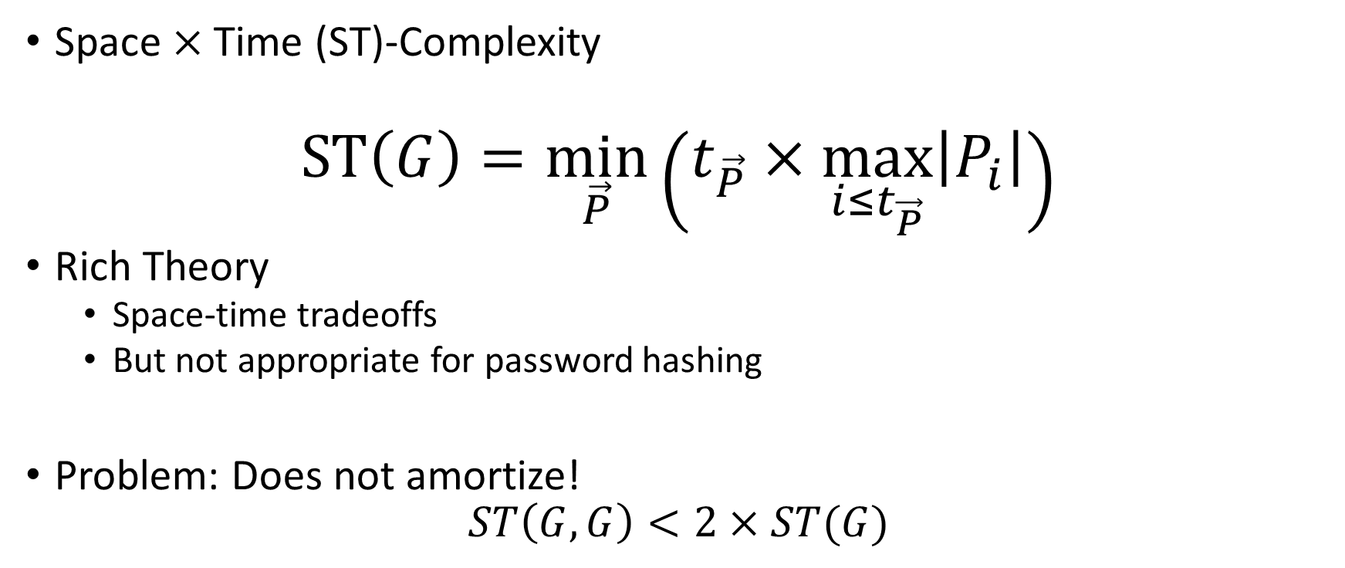
Measuring Cost: Attempt 1
Space $×$Time (ST)-Complexity
$$ST\left(G\right)=\min_{\vec{P}}\left(t_{\vec{P}}×\max_{i≤t_{\vec{P}}}\left|P_{i}\right|\right)$$
Rich Theory
  Space-time tradeoffs
  But not appropriate for password hashing
Problem: Does not amortize!
$$ST\left(G,G\right)<2×ST(G)$$

Slide 19
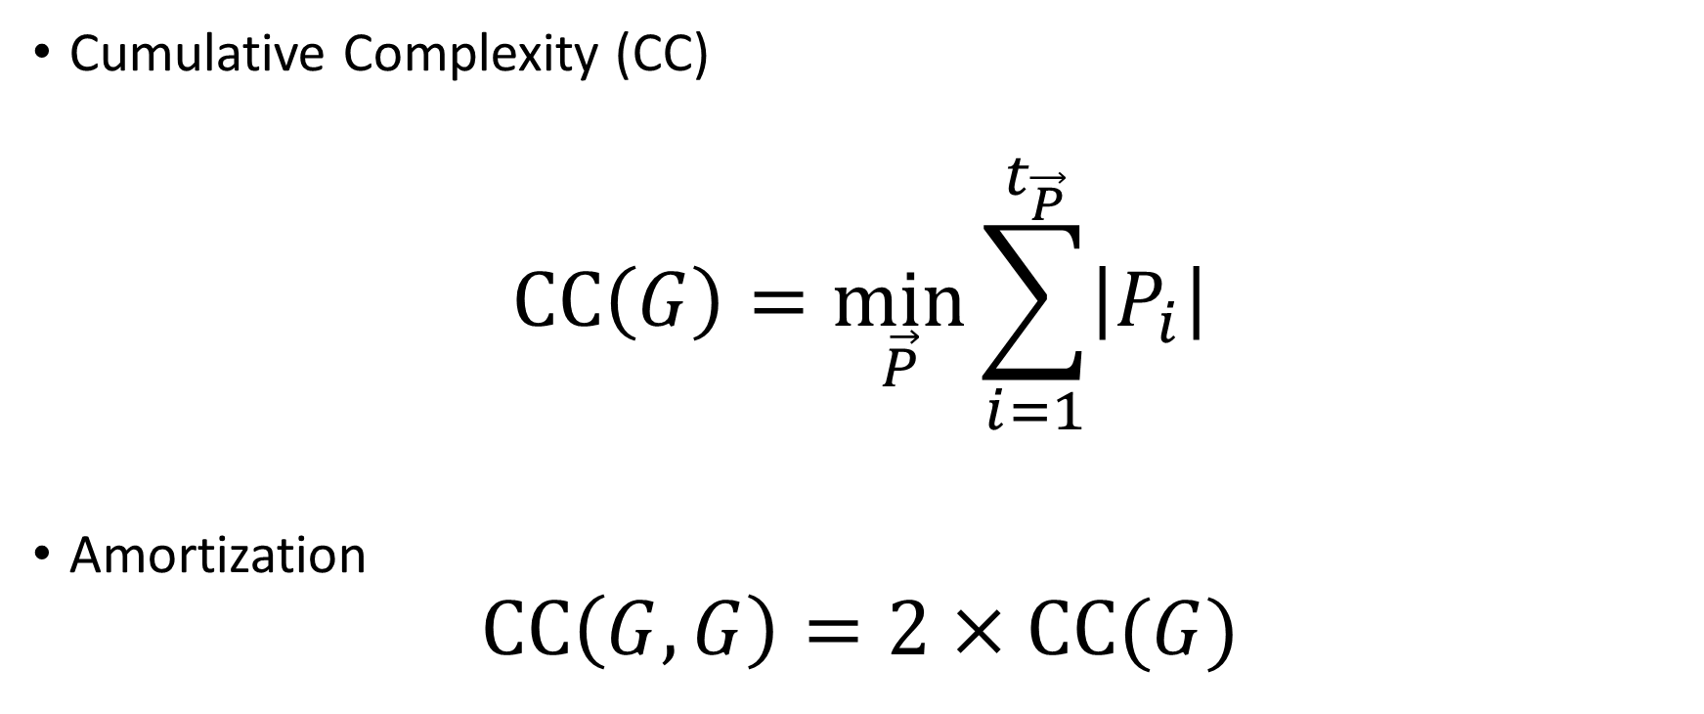
Measuring Cost: Attempt 2
Cumulative Complexity (CC)
$$CC\left(G\right)=\min_{\vec{P}}{\sum_{i=1}^{t_{\vec{P}}}{\left|P_{i}\right|}}$$
Amortization
$$CC\left(G,G\right)=2×CC(G)$$

Slide 20
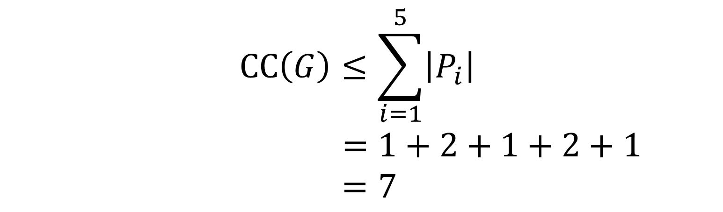
Pebbling Example (CC)
1
2
3
4
5
P₁ = {1}
$$CC\left(G\right)≤\sum_{i=1}^{5}{\left|P_{i}\right|}$$
$$=1+2+1+2+1$$
$=7$
P₂ = {1,2}
P₃ = {3}
P₄ = {3,4}
P₅ = {5}

Slide 21
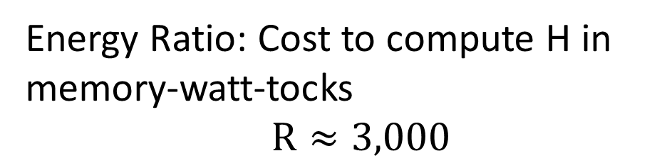

Energy Complexity
$$ER\left(G\right)=\min_{\vec{P}}{\sum_{i=1}^{t_{\vec{P}}}{\left(\left|P_{i}\right|+R\left|P_{i}\backslash P_{i−1}\right|\right)}}$$
Energy Ratio: Cost to compute H in
memory-watt-tocks
$R≈3,000$
Memory costs in
memory-watt-tocks

Slide 22

Energy Complexity
$$ER\left(G\right)=\min_{\vec{P}}{\sum_{i=1}^{t_{\vec{P}}}{\left(\left|P_{i}\right|+R\left|P_{i}\backslash P_{i−1}\right|\right)}}$$
$$ER\left(G\right)=θ\left(CC(G)\right)$$
Memory costs (equitable)
Cost of querying H (inequitable)

Slide 23

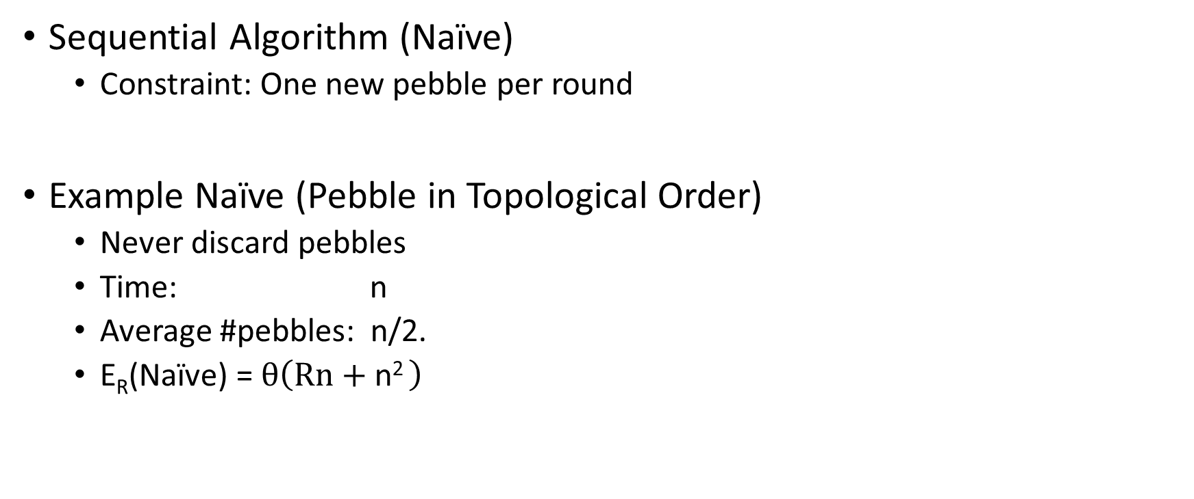
Naïve Pebbling Algorithm
Sequential Algorithm (Naïve)
  Constraint: One new pebble per round
Example Naïve (Pebble in Topological Order)
  Never discard pebbles
  Time: n
  Average #pebbles: n/2.
  E_{R}(Naïve) = $θ\left(Rn+\text{n}\text{2 }\right)$

Slide 24

Amortized Attack Quality
$$QualityR\left(A\right)=\frac{\text{E}\text{R}\text{(}\text{Na}\text{ï}\text{ve}\text{)}}{ER\left(A\right)}×\#inst(A)$$

Slide 25
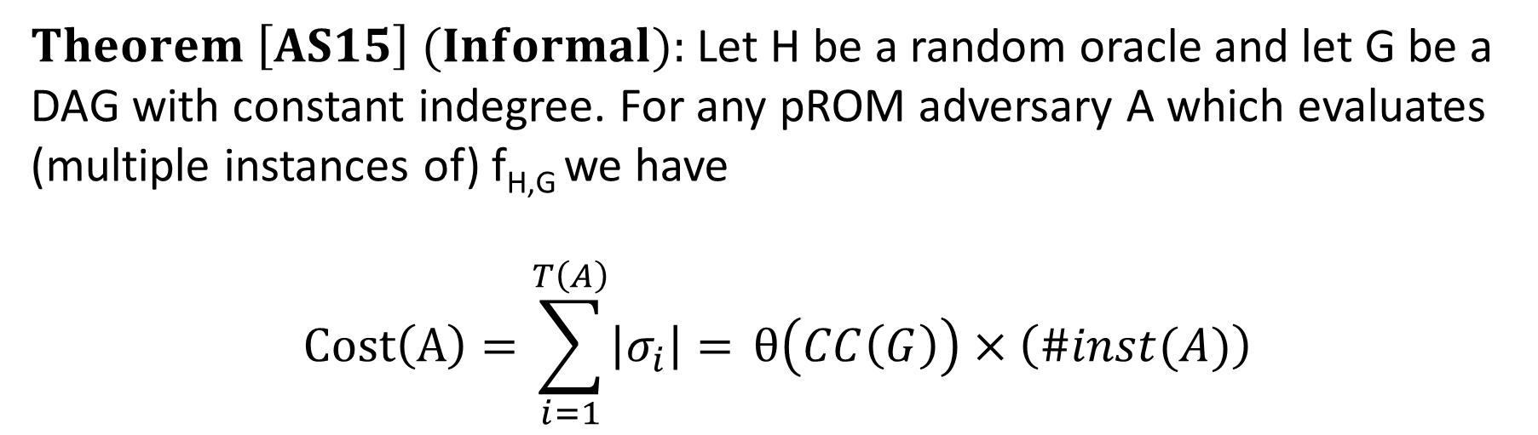
Pebbling Equivalence
$Theorem \left[AS15\right] (Informal):$Let H be a random oracle and let G be a DAG with constant indegree. For any pROM adversary A which evaluates (multiple instances of) f_{H,G} we have
$$Cost\left(A\right)=\sum_{i=1}^{T\left(A\right)}{\left|σ_{i}\right|= }θ\left(CC\left(G\right)\right)×\left(\#inst(A)\right)$$

Slide 26

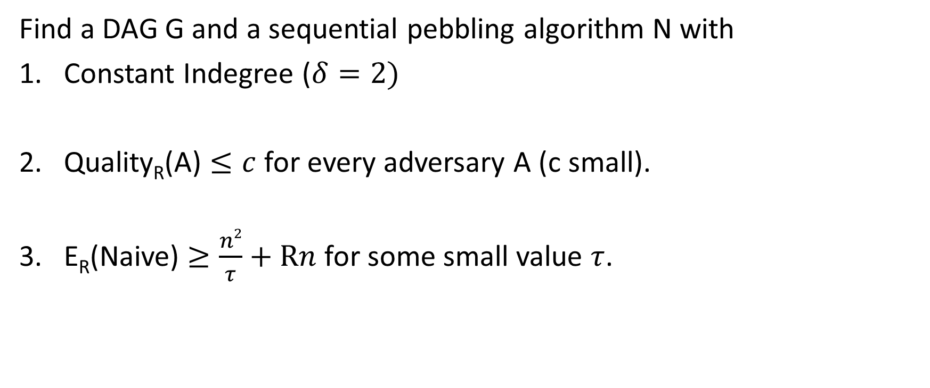
Desiderata
Find a DAG G and a sequential pebbling algorithm N with
Constant Indegree ($δ=2)$
Quality_{R}(A) $≤c$ for every adversary A (c small).
E_{R}(Naive) $≥\frac{n2}{τ}+Rn$ for some small value $τ$.

Slide 27
Desiderata
Find a DAG G and a sequential pebbling algorithm N with
Constant Indegree ($δ=2)$
Quality_{R}(A) $≤c$ for every adversary A (c small).
E_{R}(Naive) $≥\frac{n2}{τ}+Rn$ for some small value $τ$.
…
1
2
3
n
Notes:
The following DAG satisfies Goals 1 and 2, but not 3.

Slide 28
Desiderata
Find a DAG G and a sequential pebbling algorithm N with
Constant Indegree ($δ=2)$
Quality_{R}(A) $≤c$ for every adversary A (c small).
E_{R}(Naive) $≥\frac{n2}{τ}+Rn$ for some small value $τ$.
…
1
2
3
n

Slide 29
Desiderata
Find a DAG G and a sequential pebbling algorithm N with
Constant Indegree ($δ=2)$
Quality_{R}(A) $≤c$ for every adversary A (c small).
E_{R}(Naive) $≥\frac{n2}{τ}+Rn$ for some small value $τ$.
…
1
2
3
n

Slide 30
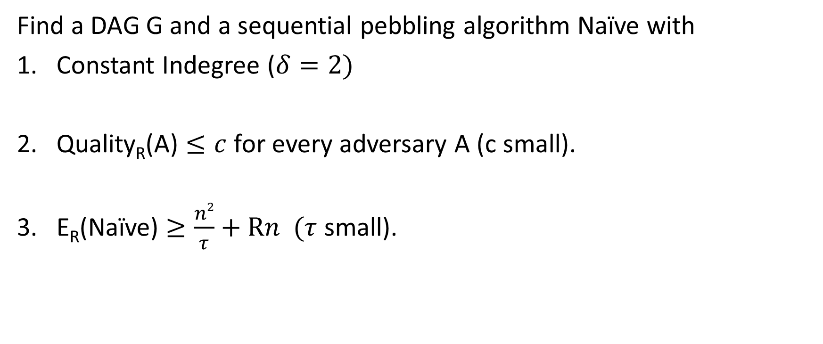
Desiderata
Find a DAG G and a sequential pebbling algorithm Naïve with
Constant Indegree ($δ=2)$
Quality_{R}(A) $≤c$ for every adversary A (c small).
E_{R}(Naïve) $≥\frac{n2}{τ}+Rn$ $(τ$ small).
…
1
2
3
n

Slide 31
Desiderata
E_{R}(Naive)=E_{R}(G)=n+Rn
Cost dominated by queries to H
(inequitable)
Find a DAG G and a sequential pebbling algorithm N with
Constant Indegree ($δ=2)$
Quality_{R}(A) $≤c$ for every adversary A (c small).
E_{R}(Naive) $≥\frac{n2}{τ}+Rn$ for some small value $τ$.
…
1
2
3
n

Slide 32
Desiderata
Find a DAG G and a sequential pebbling algorithm N with
Constant Indegree ($δ=2)$
Quality_{R}(A) $≤c$ for every adversary A (c small).
E_{R}(Naive) $≥\frac{n2}{τ}+Rn$ for some small value $τ$.
Memory costs should dominate

Slide 33
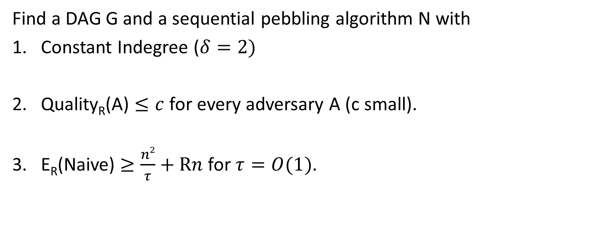
c-Ideal iMHF
Find a DAG G and a sequential pebbling algorithm N with
Constant Indegree ($δ=2)$
Quality_{R}(A) $≤c$ for every adversary A (c small).
E_{R}(Naive) $≥\frac{n2}{τ}+Rn$ for $τ=O(1)$.

Slide 34
Outline
Motivation
Data Independent Memory Hard Functions (iMHFs)
Attacks
  General Attack on Non Depth Robust DAGs
  Existing iMHFs are not Depth Robust
  No c-Ideal iMHF exists
Constructing iMHFs (New!)
Open Questions

Slide 35

Depth Robustness
Definition: A DAG G=(V,E) is (e,d)-reducible if there exists $S⊆V$
s.t. $\left|S\right|≤e$ and depth(G-S) $≤d.$
Otherwise, we say that G is (e,d)-depth robust.
Example: (1,2)-reducible
1
2
3
4
5

Slide 36
Depth Robustness
Definition: A DAG G=(V,E) is (e,d)-reducible if there exists $S⊆V$
s.t. $\left|S\right|≤e$ and depth(G-S) $≤d.$
Otherwise, we say that G is (e,d)-depth robust.
Example: (1,2)-reducible
1
2
3
4
5

Slide 37
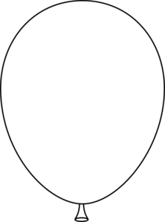
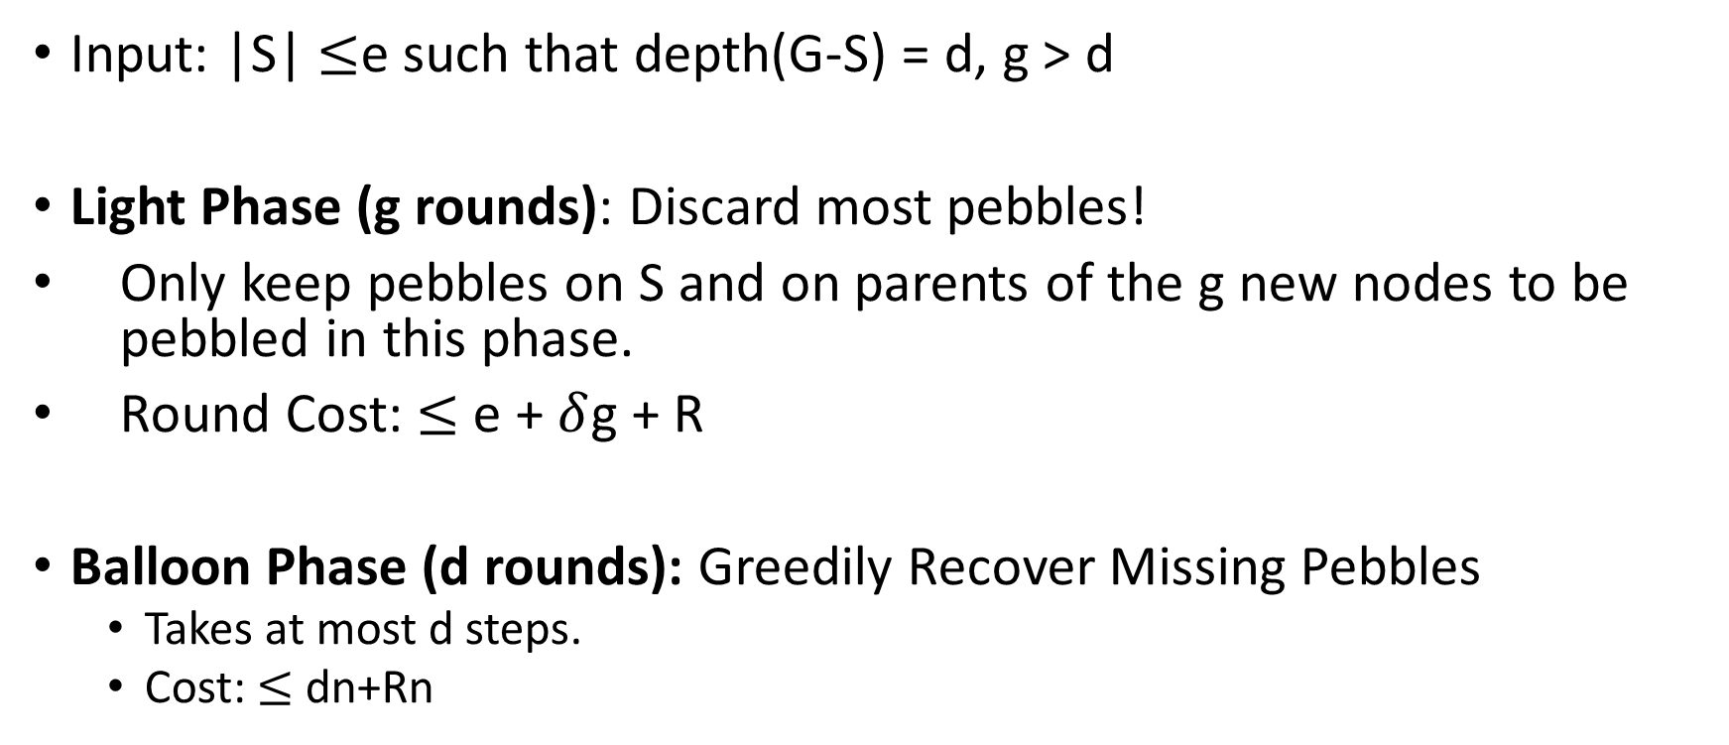
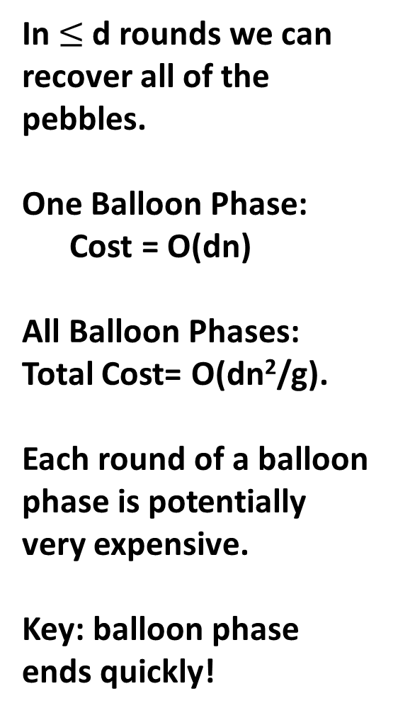
Attacking (e,d)-reducible DAGs
Input: |S| $≤$e such that depth(G-S) = d, g > d
Light Phase (g rounds): Discard most pebbles!
Only keep pebbles on S and on parents of the g new nodes to be pebbled in this phase.
Round Cost: $≤$ e + $δ$g + R
Balloon Phase (d rounds): Greedily Recover Missing Pebbles
  Takes at most d steps.
  Cost: $≤$ dn+Rn
In $≤$d rounds we can recover all of the pebbles.
One Balloon Phase:
Cost = O(dn)
All Balloon Phases:
Total Cost= O(dn²/g).
Each round of a balloon phase is potentially very expensive.
Key: balloon phase ends quickly!
Light Phase: Discard most pebbles!
Only keep pebbles on parents of next g nodes.
One Light Phase: Cost = O(g|S|)
All Light Phases: Total Cost = O(g|S|(n/g))= O(n|S|)

Slide 38
Attacking (e,d)-reducible DAGs
In $≤$d rounds we can recover all of the pebbles.
One Balloon Phase:
Cost = O(dn)
All Balloon Phases:
Total Cost= O(dn²/g).
Each round of a balloon phase is potentially very expensive.
Key: balloon phase ends quickly!

Slide 39

Main Theorem
Theorem (Depth-Robustness is a necessary condition): If G is (e,d)-reducible then is an (efficient) attack A such that
$\operatorname{ER}\left(A\right)≤en+δgn+\frac{n}{g}nd+nR+ \frac{n}{g}n$R.

Slide 40

Main Theorem
Theorem (Depth-Robustness is a necessary condition): If G is (e,d)-reducible then is an (efficient) attack A such that
$\operatorname{ER}\left(A\right)≤en+δgn+\frac{n}{g}nd+nR+ \frac{n}{g}n$R.
Never delete pebbles
from nodes $x∈S$, where
$$\left|S\right|=e$$
depth(G-S) $≤d$
#pebbling rounds

Slide 41
Main Theorem
Theorem (Depth-Robustness is a necessary condition): If G is (e,d)-reducible then is an (efficient) attack A such that
$\operatorname{ER}\left(A\right)≤en+δgn+\frac{n}{g}nd+nR+ \frac{n}{g}n$R.
Maintain pebbles on parents of next g nodes to be pebbled.
#pebbling rounds

Slide 42

Main Theorem
Theorem (Depth-Robustness is a necessary condition): If G is not (e,d)-node robust then is an (efficient) attack A such that
$\operatorname{ER}\left(A\right)≤en+δgn+\frac{n}{g}nd+nR+ \frac{n}{g}n$R.
Length of a balloon phase
#balloon phases
Max #pebbles on G
In each round of balloon phase

Slide 43

Main Theorem
Theorem (Depth-Robustness is a necessary condition): If G is not (e,d)-node robust then is an (efficient) attack A such that
$\operatorname{ER}\left(A\right)≤en+δgn+\frac{n}{g}nd+nR+ \frac{n}{g}n$R.
Set $g=\sqrt{nd}$
$\operatorname{ER}\left(A\right)=O\left(en+\sqrt{n3d}\right)$ .

Slide 44
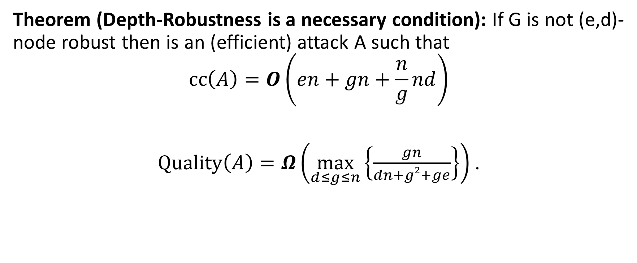
Main Theorem
Theorem (Depth-Robustness is a necessary condition): If G is not (e,d)-node robust then is an (efficient) attack A such that
$$\operatorname{cc}\left(A\right)=O\left(en+gn+\frac{n}{g}nd\right)$$
$\operatorname{Quality}\left(A\right)=Ω\left(\max_{d≤g≤n}\left\{\frac{gn}{dn+g2+ge}\right\}\right)$ .

Slide 45

Question
Are existing iMHF candidates based on depth-robust DAGs?

Slide 46

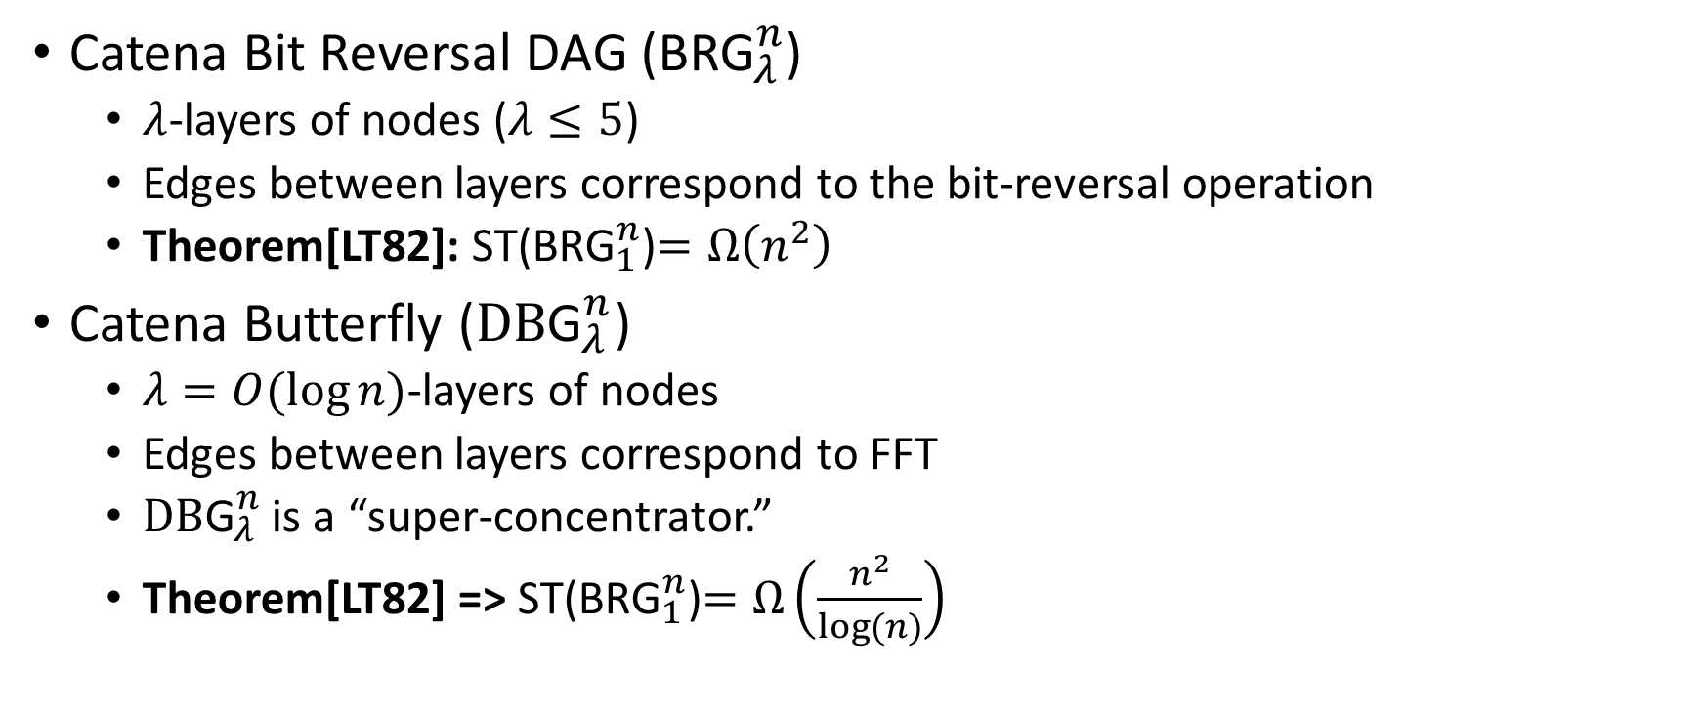
Catena
Catena Bit Reversal DAG (${\text{BRG}}_{λ}^{n}$)
  $λ$-layers of nodes ($λ≤5$)
  Edges between layers correspond to the bit-reversal operation
  Theorem[LT82]: ST(${\text{BRG}}_{1}^{n}$)$=Ω\left(n^{2}\right)$
Catena Butterfly (${\text{DB}\text{G}}_{λ}^{n}$)
  $λ=O(\log{n)}$-layers of nodes
  Edges between layers correspond to FFT
  ${\text{DB}\text{G}}_{λ}^{n}$ is a “super-concentrator.”
  Theorem[LT82] => ST(${\text{BRG}}_{1}^{n}$)$=Ω\left(\frac{n^{2}}{log⁡(n)}\right)$
Notes:
Thomas Lengauer and Robert Endre Tarjan. Asymptotically Tight Bounds on Time-Space Trade-oﬀs in a Pebble Game. J. ACM, 29(4):1087–1130, 1982

Slide 47
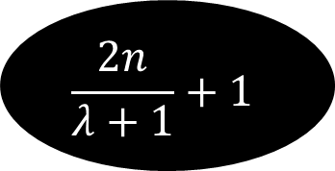
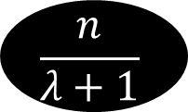

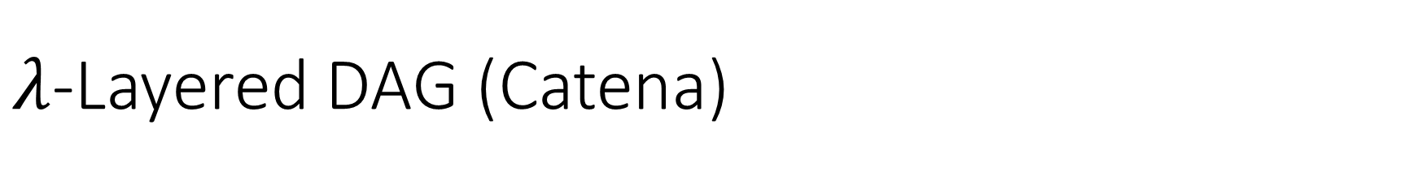
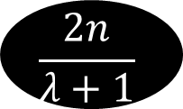
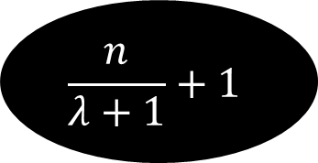
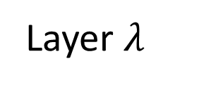
$λ$-Layered DAG (Catena)
…
$$\frac{2n}{λ+1}+1$$
2
3
4
5
$$\frac{n}{λ+1}$$
Layer $λ$
…
…
…
$$\frac{n}{λ+1}+1$$
+2
+3
4
5
$$\frac{2n}{λ+1}$$
Layer 1
…
1
2
3
4
5
$$\frac{n}{λ+1}$$
Layer 0

Slide 48
$λ$-Layered DAG (Catena)
…
$$\frac{2n}{λ+1}+1$$
2
3
4
5
$$\frac{n}{λ+1}$$
Layer $λ$
…
…
…
$$\frac{n}{λ+1}+1$$
+2
+3
4
5
$$\frac{2n}{λ+1}$$
Layer 1
…
1
2
3
4
5
$$\frac{n}{λ+1}$$
Layer 0

Slide 49
$λ$-Layered DAG (Catena)
…
$$\frac{2n}{λ+1}+1$$
2
3
4
5
$$\frac{n}{λ+1}$$
Layer $λ$
…
…
…
$$\frac{n}{λ+1}+1$$
+2
+3
4
5
$$\frac{2n}{λ+1}$$
Layer 1
…
1
2
3
4
5
$$\frac{n}{λ+1}$$
Layer 0
Disallowed! All edges must go to a higher layer (except for (i,i+1))

Slide 50
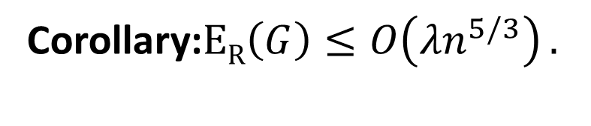

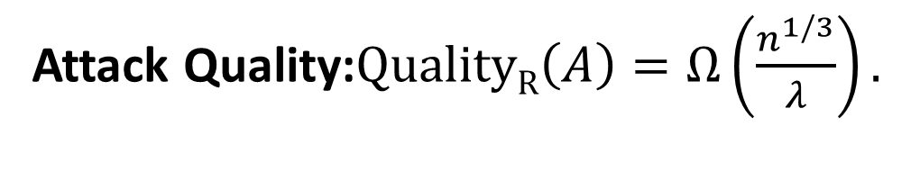
Layered Graphs are Reducible
Theorem (Layered Graphs Not Depth Robust): Let G be a $λ$-Layered DAG then G is $\left(n^{2/3},n^{1/3}\left(λ+1\right)\right)$-reducible.
Corollary:$\operatorname{ER}\left(G\right)≤O\left({λn}^{5/3}\right).$
Attack Quality:$\operatorname{QualityR}\left(A\right)=Ω\left(\frac{n^{1/3}}{λ}\right).$

Slide 51

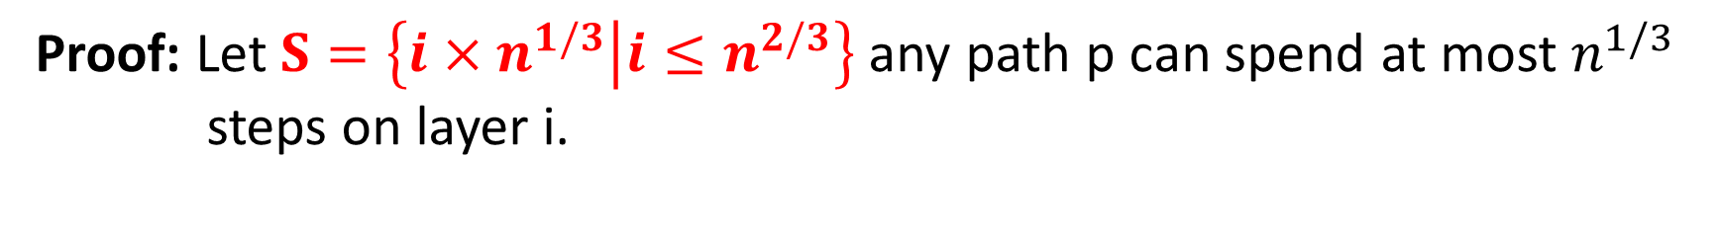




Layered Graphs are Reducible
Theorem (Layered Graphs Not Depth Robust): Let G be a $λ$-Layered DAG then G is $\left(n^{2/3},n^{1/3}\left(λ+1\right)\right)$-reducible.
Proof: Let$S=\left\{{i×n}^{1/3} | {i≤n}^{2/3}\right\}$ any path p can spend at most $n^{1/3}$
steps on layer i.
…
…
…
…
…
…
2
$$\frac{n}{λ+1}$$
Layer 0
1
$$n^{1/3}$$
$${2n}^{1/3}$$
$$n^{1/3}$$
$$n^{1/3}$$

Slide 52
Layered Graphs are Reducible
Theorem (Layered Graphs Not Depth Robust): Let G be a $λ$-Layered DAG then G is $\left(n^{2/3},n^{1/3}\left(λ+1\right)\right)$-reducible.
Proof: Let$S=\left\{{i×n}^{1/3} | {i≤n}^{2/3}\right\}$ any path p can spend at most $n^{1/3}$
steps on layer i.
…
…
…
…
…
…
2
$$\frac{n}{λ+1}$$
Layer 0
1
$$n^{1/3}$$
$${2n}^{1/3}$$
$$n^{1/3}$$
$$n^{1/3}$$

Slide 53
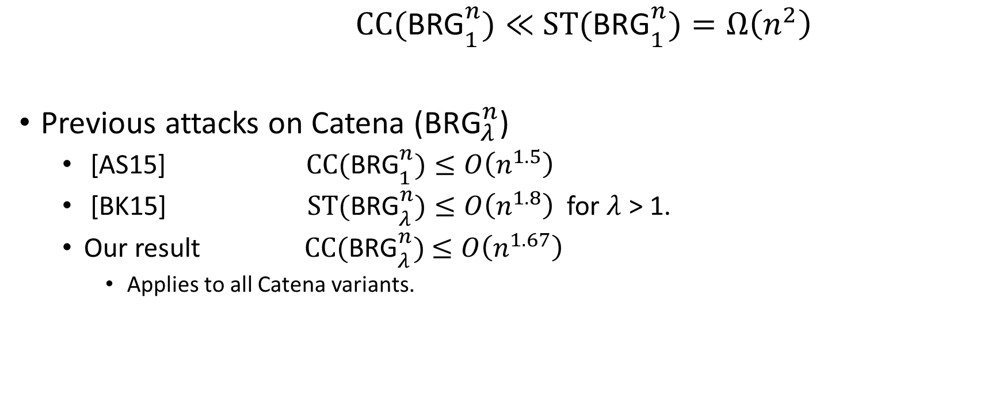
ST complexity vs CC complexity
$${ \text{CC}\text{(}\text{BRG}}_{1}^{n})≪{ \text{ST}\text{(}\text{BRG}}_{1}^{n})=Ω\left(n^{2}\right)$$
Previous attacks on Catena (${\text{BRG}}_{λ}^{n}$)
  [AS15] ${ \text{CC}\text{(}\text{BRG}}_{1}^{n})≤O\left(n^{1.5}\right)$
  [BK15] ${ \text{ST}\text{(}\text{BRG}}_{λ}^{n})≤O\left(n^{1.8}\right)$ for $λ$ > 1.
  Our result ${\text{CC}\text{(}\text{BRG}}_{λ}^{n})$ $≤O\left(n^{1.67}\right)$
    Applies to all Catena variants.
Notes:
Alwen/Serbinenko
Alex Biryukov and Dmitry Khovratovich

Slide 54

Argon2i [BDK]
Argon2: Winner of the password hashing competition[2015]
Authors recommend Argon2i variant (data-independent) for password hashing.
Notes:
Alex Biryukov, Daniel Dinu, and Dmitry Khovratovich from University of Luxembourg.

Slide 55
Argon2i
…
1
2
3
4
i
n

Slide 56
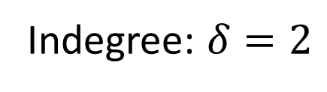
Argon2i
random predecessor r(i) < i
…
1
2
3
4
i
n
Indegree: $δ=2$

Slide 57

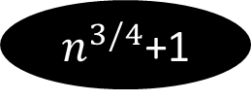




Argon2i is a layered DAG (almost)
…
…
n
Layer $\sqrt[4]{n}$
…
…
$n^{3/4}$+1
+2
+3
+$\sqrt[4]{n}$
$${2n}^{3/4}$$
Layer 1
…
…
1
2
3
$$\sqrt[4]{n}$$
$$n^{3/4}$$
Layer 0

Slide 58


Argon2i is a layered DAG (almost)
Definition: $S2=\left\{vi | v_{r(i)}and vi in same layer\right\}$
…
…
n
Layer $\sqrt[4]{n}$
…
…
$n^{3/4}$+1
+2
+3
+$\sqrt[4]{n}$
$${2n}^{3/4}$$
Layer 1
…
…
1
2
3
$$\sqrt[4]{n}$$
$$n^{3/4}$$
Layer 0
$$Claim: E\left[S2\right]=O\left(n^{3/4}\log{n}\right)$$

Slide 59






Argon2i is a layered DAG (almost)
Definition: $S2=\left\{vi | v_{r(i)}and vi in same layer\right\}$
…
…
Layer $\sqrt[4]{n}$
…
…
$n^{3/4}$+1
+2
+3
+$\sqrt[4]{n}$
$${2n}^{3/4}$$
Layer 1
…
…
1
2
3
$$\sqrt[4]{n}$$
$$n^{3/4}$$
Layer 0
$$\text{Pr}\left[v∈S2\left|v in Layer i\right.\right]≤\frac{1}{i}$$
$$E\left[Layer i∩S2\right]≤\frac{n^{3/4}}{i}$$

Slide 60
Argon2i is a layered DAG (almost)
Definition: $S2=\left\{vi | v_{r(i)}and vi in same layer\right\}$
…
…
n
Layer $\sqrt[4]{n}$
…
…
$n^{3/4}$+1
+2
+3
+$\sqrt[4]{n}$
$${2n}^{3/4}$$
Layer 1
…
…
1
2
3
$$\sqrt[4]{n}$$
$$n^{3/4}$$
Layer 0
$$Claim: E\left[S2\right]=O\left(n^{3/4}\log{n}\right)$$

Slide 61

Argon2i is a layered DAG (almost)
Let S = S₁+S₂
…
…
n
Layer $\sqrt[4]{n}$
…
…
$n^{3/4}$+1
+2
+3
+$\sqrt[4]{n}$
$${2n}^{3/4}$$
Layer 1
…
…
1
2
3
$$\sqrt[4]{n}$$
$$n^{3/4}$$
Layer 0
$Fact: E\left[S\right]=O\left(n^{3/4}\log{n}\right)$ and depth(G-S)$≤\sqrt{n}.$

Slide 62
Argon2i is a layered DAG (almost)
Let S = S₁+S₂
…
…
n
Layer $\sqrt[4]{n}$
…
…
$n^{3/4}$+1
+2
+3
+$\sqrt[4]{n}$
$${2n}^{3/4}$$
Layer 1
…
…
1
2
3
$$\sqrt[4]{n}$$
$$n^{3/4}$$
Layer 0
$Theorem:$G is (2$n^{3/4}\log{n}$, $\sqrt{n}$)-reducible with high probability.

Slide 63


Argon2i is a layered DAG (almost)
Let S = S₁+S₂
…
…
n
Layer $\sqrt[4]{n}$
…
…
$n^{3/4}$+1
+2
+3
+$\sqrt[4]{n}$
$${2n}^{3/4}$$
Layer 1
…
…
1
2
3
$$\sqrt[4]{n}$$
$$n^{3/4}$$
Layer 0
Corollary:$\operatorname{ER}\left(G\right)≤O\left(n^{7/4}\log{n}\right).$
$\operatorname{QualityR}\left(A\right)≤Ω\left(\frac{n^{1/4}}{\log{n}}\right).$

Slide 64

Do c-Ideal iMHFs exist?
Reminder: DAG G and a sequential pebbling algorithm N with
Constant Indegree ($δ=2)$
Quality_{R}(A) $≤c$ for every adversary A (c small).
E_{R}(Naive) $≥\frac{n2}{τ}+Rn$ for $τ=O(1)$.
$Thm[AS15]:$There is a DAG G with $CC\left(G\right)=Ω\left(\frac{n^{2}}{\log^{10+ε}{n} }\right)$and $δ$=2.
$Corollary:$G is c=polylog(n)-Ideal.

Slide 65



Do c-Ideal iMHFs exist?
$Lemma[Valiant77]:$Let G=(V,E) be a DAG with depth $d≤n$ then there is a set S$⊂V$ of at most $\left(\frac{nδ}{\log{d}}\right)$ nodes such that depth(G-S)$≤d/2$.
$Theorem:$Let G=(V,E) be a DAG with n nodes then there is a set S$⊂V$ of $\left(\frac{nδlog log{n}}{\log{n}}\right)$ edges such that depth(G-S)$≤n/{\log{n}}$.
$Corollary:$Let G=(V,E) be a DAG with n nodes then for any constant $ε>0$
$$ER\left(G\right)=o\left(\frac{n^{2}}{\log^{1−ε}{n}}\right)$$

Slide 66


Do c-Ideal iMHFs exist?
$Corollary:$Let G=(V,E) be a DAG with n nodes then for any constant $ε>0$
$$ER\left(G\right)=o\left(\frac{n^{2}}{\log^{1−ε}{n}}\right)$$
NO! If c=O(1).

Slide 67


















Light Phase Units
Light Phase Units
Balloon Phase Unit
Instance n^{1/4}/2+1
Instance 1
$$H$$
$$H$$
Instance 2
Instance n^{1/4}/2+2
$$H$$
$$H$$
…
$H$₁
…
$$H_{\sqrt{n}}$$
Instance i
Instance n^{1/4}-1
$H$₂
$$H$$
$$H$$
$H$₃
…
…
Instance n^{1/4}/2
Instance n^{1/4}
$$H$$
$$H$$

Slide 68
Practical Consequences (R = 3,000)

Slide 69
Outline
Motivation
Data Independent Memory Hard Functions (iMHFs)
Attacks
Constructing iMHFs (New!)
  Joint work with Joel Alwen and Krzystof Pietrzak
Open Questions
Notes:
Joint work with Joel Alwen and Krzysztof Pietrzak

Slide 70



New (Positive) Results
$Key Theorem:$Let G=(V,E) be (e,d)-depth robust then CC(G)$≥ed$.
$Theorem[EGS75]:$There is an $\left(Ω\left(n\right),Ω\left(n\right)\right)$-depth robust DAG G with indegree $δ=O\left(\log{n}\right)$.
$Corollary:$There is a DAG G with indegree $δ=O\left(\log{n}\right)$ and
$\text{CC}\text{(}\text{G}\text{)}≥Ω\left(n^{2}\right)$.
$Theorem (Indegree Reduction):$Let G’ be a DAG with n’ = n/(2$δ′$) nodes and indegree $δ$’. If G’ is (e’,d’)-depth robust then we can construct a DAG G on n nodes such that G is (e’,d = $δ$’d’)-depth robust and has maximum indegree $δ$=2.

Slide 71



New (Positive) Results
$Theorem (Indegree Reduction):$Let G’ be a DAG with n’ = n/(2$δ′$) nodes and indegree $δ$’. If G’ is (e’,d’)-depth robust then we can construct a DAG G on n nodes such that G is (e’,d = $δ$’d’)-depth robust and has maximum indegree $δ$=2.
$Corollary:$There is a DAG G with maximum indegree $δ=2$ and
$\text{CC}\text{(}\text{G}\text{)}=Ω\left(\frac{n^{2}}{\log{n}}\right)$.
$Theorem:$There is a DAG G with maximum indegree $δ=2$ and
$\text{CC}\text{(}\text{G}\text{)}=Ω\left(\frac{n^{2}}{\log{n}}\right)$. Furthermore, there is a sequential pebbling algorithm N with cost $\text{CC}\text{(}\text{N}\text{)}$ $=O\left(\frac{n^{2}}{\log{n}}\right)$.

Slide 72


(c,$τ)$-Ideal iMHFs Exist
Find a DAG G and a sequential pebbling algorithm N with
Constant Indegree ($δ=2)$
Quality_{R}(A) $≤c$ for every adversary A (c=O(1)).
E_{R}(Naive) $≥\frac{n2}{τ}+Rn$ $(τ=O(\log\left(n\right)))$.

Slide 73

Proof of Key Theorem
$Key Theorem:$Let G=(V,E) be (e,d)-depth robust then CC(G)$≥ed$.
Proof: Let P₁,…P_{t} denote an (optimal) pebbling of G. For 0< i < d define
$Si=P_{i}∪P_{d+i}∪P_{2d+i}$ $∪…$
one of the sets $Si$ has size at most CC(G)/d. Now we claim that
d $≤$depth(G-S_{i})
because any path in G-S_{i} must have been completely pebbled at some point. Thus, it must have been pebbled entirely during the some interval of length d. Thus, G is (CC(G)/d,d)-reducible. It follows that CC(G)$≥ed$.

Slide 74
Pebbling Equivalence
$Theorem \left[AS15\right] (Informal):$Let H be a random oracle and let G be a DAG with constant indegree. For any pROM adversary A which evaluates (multiple instances of) f_{H,G} we have
$$Cost\left(A\right)=\sum_{i=1}^{T\left(A\right)}{\left|σ_{i}\right|= }θ\left(CC\left(G\right)\right)×\left(\#inst(A)\right)$$

Slide 75

Miscellaneous Results
New Lower Bounds:
  CC(Argon2i) $≥\tilde{Ω}\left(n^{1.5}\right)$
  CC(Catena) $≥\tilde{Ω}\left(n^{1.5}\right)$
New Upper Bounds:
  CC(Argon2i) $=\tilde{O}\left(n^{1.71}\right)$
  CC(Catena) $=\tilde{O}\left(n^{1.618}\right)$

Slide 76
Open Questions
Computational Complexity of CC(G)
  Efficient Algorithm to Approximate CC(G)?
  Hardness of Approximation?
Improved Constructions of Depth-Robust Graphs
  Constants matter!
What is CC(Argon2i)?
  Upper Bound: n^{1.71}
  Lower Bound: n^{1.5}

